Slide 1


ENHANCING CAMPUS CONNECTIVITY
KU COLLEGE OF ENGINEERING AND TECHNOLOGY
TEAM - 11:
V.SRIVALLI - 21567T0959
D.SRUJANA-21567T0912
S .VIKASRAJ - 21567T0948
B.THARUN - 225670963L
B.PRAKASH - 21567T0907
UNDER THE GUIDANCE OF: R LAKSHMAN NAIK

Slide 2

INTRODUCTION
Welcome to our college's online platform, where faculty and students come together for seamless communication. Our website serves as a centralized hub for sharing educational materials, fostering continuous learning beyond the classroom. Our mission is to make education accessible to all, breaking down barriers and creating opportunities for growth and development. Join us in shaping the future of learning together.

Slide 3
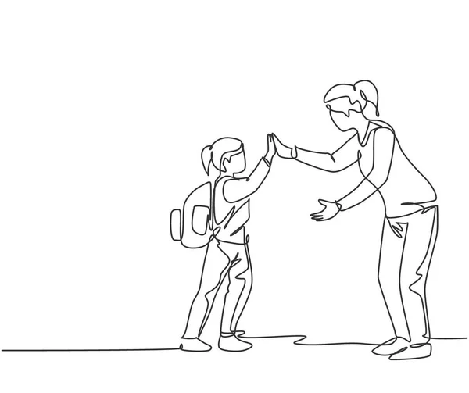
ABSTRACT
The project aims to create a user-friendly website serving as a central hub for accessing detailed information about college faculty members. It seeks to enhance the academic experience by providing insights into faculty backgrounds, expertise, research, and contact details. The website will feature an intuitive interface for easy navigation and will also offer comprehensive study materials to aid students in their learning.
Overall, the project seeks to bridge the gap between students and faculty and promote academic excellence within the college community.

Slide 4
EXISTING SYSTEM
Limited Accessibility
Delayed Communication
Resource Disorganization
Lack of Engagement
PROPOSED SYSTEM
Remote Accessibility
Real-time Communication
Centralized Resource Repository
Interactive Features

Slide 5
ADVANTAGES
Students can access course materials from any available device.
Easy to retrieve the faculty information and interaction.
Fostering a Sense Mentorship.
Achieving Academic Success.

Slide 6
DOMAIN
The development of this website will involve utilizing modern web development technologies, including…
HTML
CSS
JAVA SCRIPT
Backend Frameworks:
PHP
MySQL

Slide 7
THANK YOU!!

